Slide 1
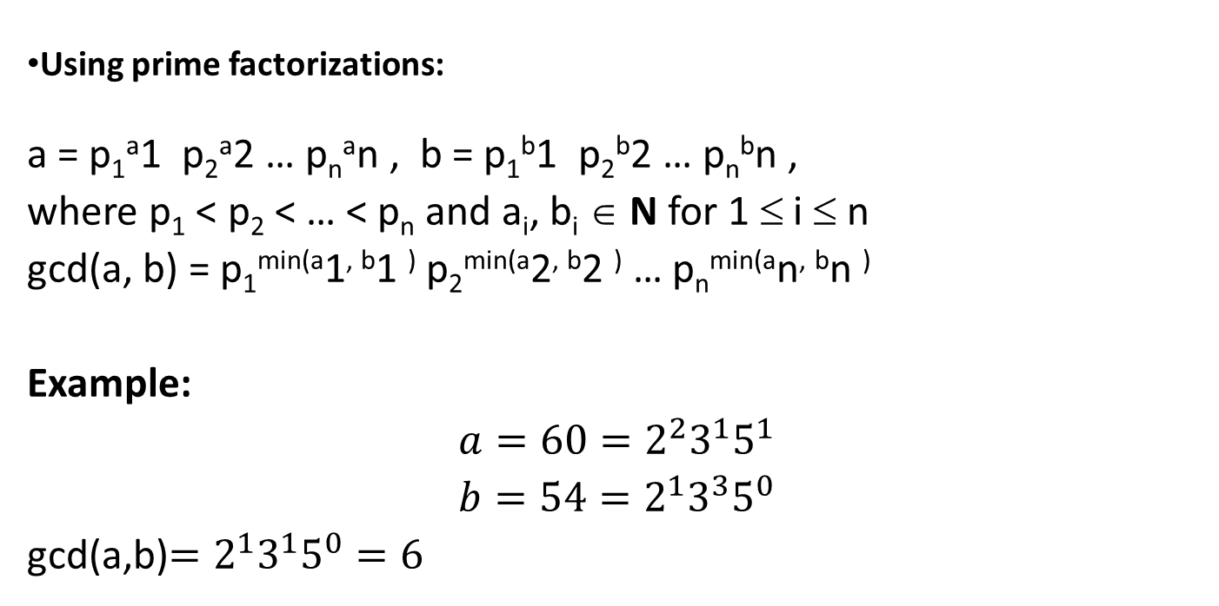
1.3: Primes and Greatest Common Divisors
GREATEST COMMON DIVISORS
Using prime factorizations:
a = p₁ª1 p₂ª2 … p_{n}ªn , b = p₁^{b}1 p₂^{b}2 … p_{n}^{b}n ,
where p₁ < p₂ < … < p_{n} and a_{i}, b_{i} ∈ N for 1 ≤ i ≤ n
gcd(a, b) = p₁^{min(a}1^{, b}1 ⁾ p₂^{min(a}2^{, b}2 ⁾ … p_{n}^{min(a}n^{, b}n ⁾
Example:
$$a=60=2^{2}3^{1}5^{1}$$
$$b=54=2^{1}3^{3}5^{0}$$
gcd(a,b)$=2^{1}3^{1}5^{0}=6$

Slide 2
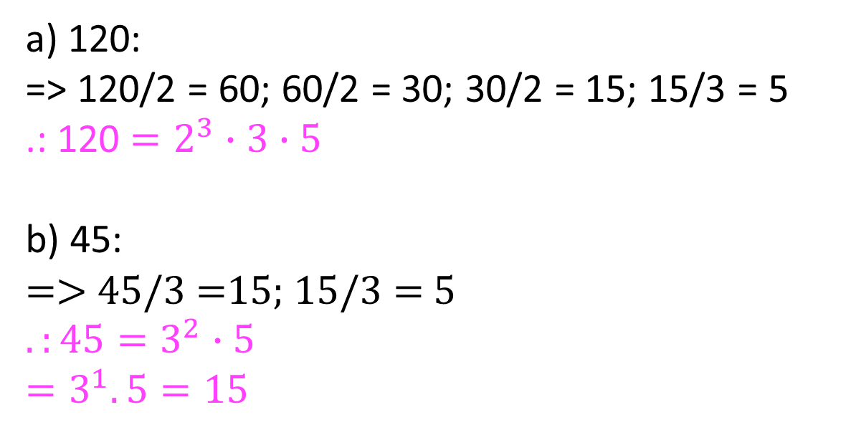
SCST1213 Mathematics For SE
1.3: Primes and Greatest Common Divisors
EXERCISES - Solution (3)
a) 120:
=> 120/2 = 60; 60/2 = 30; 30/2 = 15; 15/3 = 5
.: 120 $=2^{3}∙3∙5$
b) 45:
=> 45/3 =15; 15/3 = 5
$$.:45=3^{2}∙5$$
$$=3^{1}.5=15$$
2
nzah@utm.my

